Slide 1



Predicting Device Vulnerability via Machine Learning
Brandon Gray
Md Sanzid Bin Hossain
Nabila Shahnaz Khan
Project Group 32

Slide 2
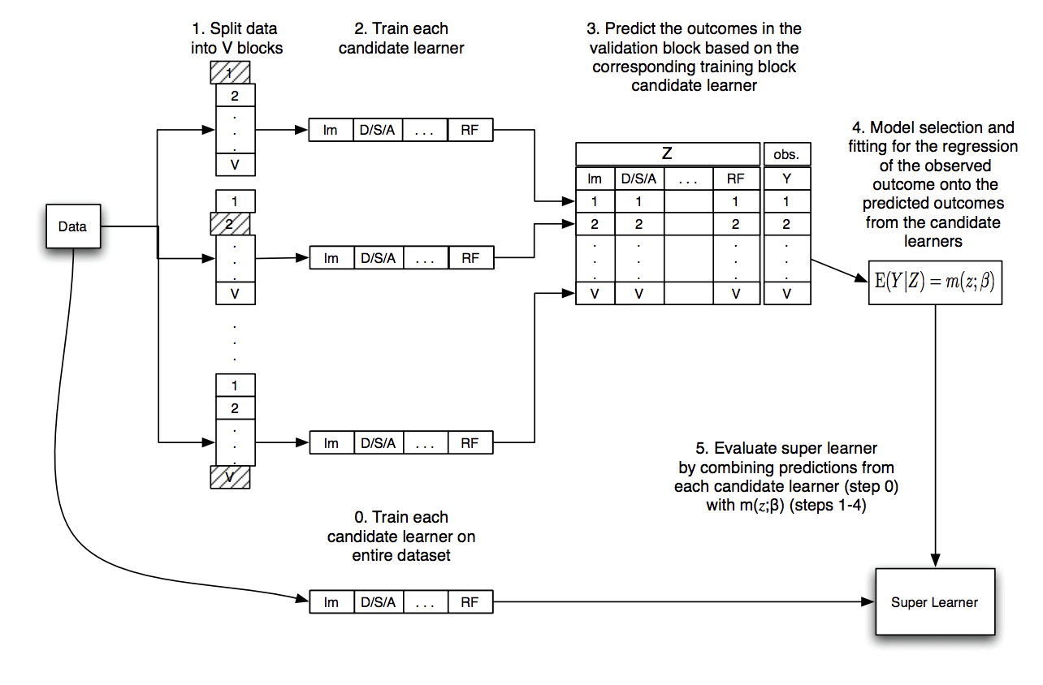
Proposed Approach
Implementing a Super Learner based on multiple learner models
Steps:
Splitting the training dataset into V blocks
Selecting m (m = 4) base models as base learners
Evaluate each base learner using k-fold cross-validation
Store all out-of-fold predictions of the base learners
Fit the base learners on the full training dataset and store
Fit a meta-model on the out-of-fold predictions as super leaner
Evaluate the super learner based on the testing dataset
Different Machine Learning Binary Classifier models to be used are: Gradient boosting, SVM, KNN, Random Forest
Figure: Data Flow of Super Learner Algorithm [3]

Slide 3
Progress on Check Point 1
Exploratory Data Analysis
Initial Data Preprocessing
Preliminary Model Analysis
Algorithm | Accuracy | Precision | Recall | F1 Score
Random Forest | 0.65 | 0.65 | 0.65 | 0.65
SVM (1/10000 data) | 0.53 | 0.53 | 0.53 | 0.51
KNN (1/20 data) | 0.61 | 0.61 | 0.61 | 0.60
(Light) Gradient Boosting | 0.66 | 0.66 | 0.66 | 0.66

Slide 4
Data Preprocessing
About 9 million data objects
83 features, mostly nominal, some ratio
44 columns had missing values, 61 features had cardinality (max cardinality 200348, min cardinality 2)
10 High Cardinality features (unique values greater than 500) were dropped
6 features with missing values greater than 40% were dropped
Remaining 67 features were segregated as numerical and categorical features
For numerical features, data rows with missing values were dropped
Categorical features were converted into numerical features using label encoder where missing values were encoded as –1, making them a separate category for each feature●, making them a separate category for each feature
●High cardinality features (unique values greater than 500) were automatically dropped-10 features
●High cardinality features (unique values greater than 500) were automatically dropped-10 features
200348

Slide 5
Implemented Models
Model | Sample Size (%) | Accuracy | Weakness | Strength
Gaussian Naïve Bayes | 100% | 0.5004 | Most features categorical | Runtime
Multimodal Naïve Bayes | 1% | 0.5048 | Continuous features, accuracy | -
Support Vector Machine | 1% | 0.5312 | Runtime, accuracy | -
Multi-layer Perceptron Classifier | 5% | 0.5143 | Runtime, accuracy | -
Gaussian Mixture | 1% | 0.5200 | Accuracy | Runtime
Logistic Regression | 1% | 0.6300 | - | Runtime, accuracy
Ridge Classifier | 1% | 0.6200 | - | Runtime, accuracy
Random Forest Classifier | 100% | 0.6500 | not memory efficient | Runtime, Skewness
KNN | 1% | 0.6100 | Runtime | Accuracy
Gradient Boosting Classifier | 100% | 0.66503 | - | Accuracy, Runtime
LGBM Classifier | 100% | 0.67191 | - | Accuracy, Runtime
XGB Classifier | 100% | 0.65593 | Accuracy | -
Cat Boost Classifier | 100% | 0.67563 | - | Accuracy, Runtime
AdaBoost Classifier | 100% | 0.65041 | Accuracy | Accuracy, Runtime
Notes:
In this slide, we are showing the results of models that we have used to train the model. In addition to the accuracy, we show the sample size of the training data to train the model. The most prominent weakness of the models are the accuracy and runtime. For that reason, we have to reduce the sample size for certain models. Among all the models, family of boosting algorithm provides the highest accuracy while reducing training time.

Slide 6
Super Learner Implementation
Based on High Accuracy, finally selected the models Gradient Boosting Classifier, LGBM Classifier, XGB Classifier, Cat Boost Classifier, AdaBoost Classifier
5 folds cross validation was used to train the SuperLearner
Used Ridgeclassifier as meta-learner- Better accuracy, less runtime
Gradually decreased number of base learners to improve accuracy; evaluated the effect of different number of Base models
f-1 | f-2 | f-3 | f-4 | f-5
5 Learners
GB | LGBM | XGBM | CB | AB | Obs
(f-1)’ | (f-1)’ | (f-1)’ | (f-1)’ | (f-1)’ | (f-1)’
(f-2)’ | (f-2)’ | (f-2)’ | (f-2)’ | (f-2)’ | (f-2)’
(f-3)’ | (f-3)’ | (f-3)’ | (f-3)’ | (f-3)’ | (f-3)’
(f-4)’ | (f-4)’ | (f-4)’ | (f-4)’ | (f-4)’ | (f-4)’
(f-5)’ | (f-5)’ | (f-5)’ | (f-5)’ | (f-5)’ | (f-5)’
f-1 | f-2 | f-3 | f-4 | f-5
5 Learners
Fit Super Learner
(Used Ridgeclassifier as meta-learner)
Data
f-1 | f-2 | f-3 | f-4 | f-5
5 Learners
f-1 | f-2 | f-3 | f-4 | f-5
5 Learners
f-1 | f-2 | f-3 | f-4 | f-5
5 Learners
Predicting Outcomes using Candidate Learner
Evaluate Super Learner on Testing Dataset
Dividing dataset in 5 blocks
Training Candidate Learner
Training Candidate Learners on Whole Dataset
Notes:
Considering the highest performing models and less runtime, we use five boosting algorithm to train the SuperLearner. At first, we segment the dataset into 5 blocks, train the model with 4 blocks, and testing on 5th block to create input dataset for meta learner. Five blocks reduces the training time and also gave optimal performance of the superlearner. We use Ridgeclassifier as meta-learner. It gives better accuracy and needs less training time.
At first, we train the superlearner using all the five boosting algorithm. later we gradually decrease the number of models according to their individual performance, and trained the super learner to show the effect of those models on superlearner’s performance.

Slide 7
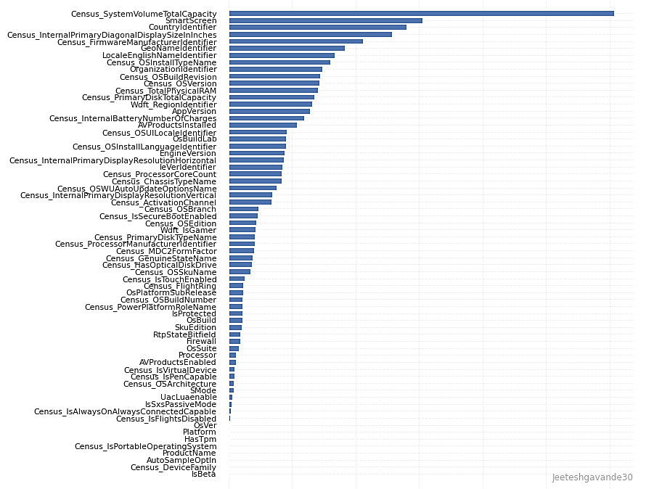
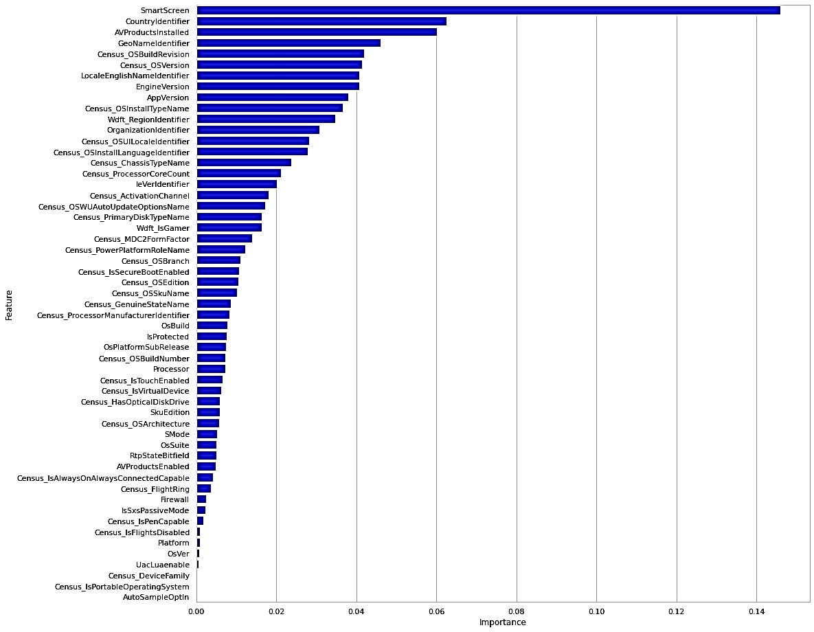
Important Feature Selection
Samplified the dataset and generated feature importance score using the models Decision Tree, Random Forest, XGB Classifier and LGB Classifier
Generated a list of common important features (sorted based on importance score)
Fig: Based on the Decision Tree Model
Fig: Based on the Random Forest Model
Notes:
We generated feature importance based on decision tree, random forest, XGB, and LGB classifier. The reason for feature selection is to choose the most important features and show their effects on the accuracy of the model.Based on the features we got from four algorithm, we combined those features according to their rank and gradually decrease the features to evaluate the performance of the model

Slide 8
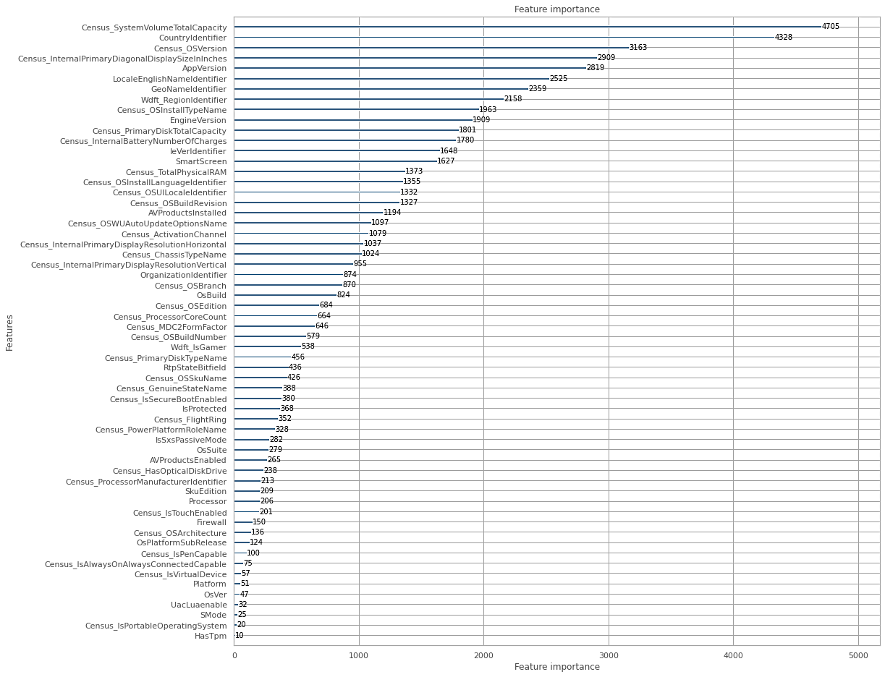
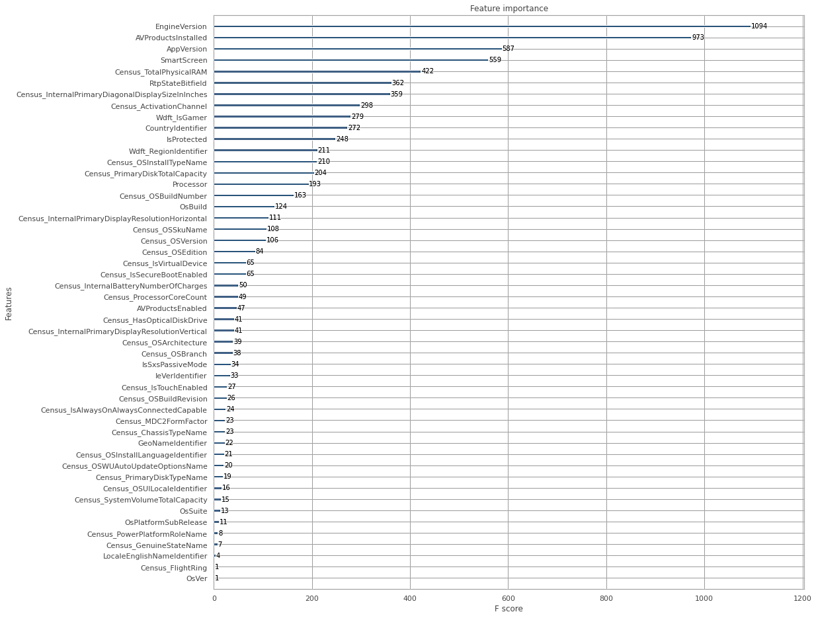
Important Feature Selection
Samplified the dataset and generated feature importance score using the models Decision Tree, Random Forest, XGB Classifier and LGB Classifier
Generated a list of common important features (sorted based on importance score)
Fig: Based on the LGBM Model
Fig: Based on the XGBM Model

Slide 9
Result Analysis Based on Feature Importance
Feature Set | Model | Accuracy | Precision | Recall | F1-Score
67 Feature set | LGBM Classifier | 0.67133 | 0.6731 | 0.6713 | 0.6713
 | Cat Boost Classifier | 0.67502 | 0.6765 | 0.6750 | 0.6751
Top 57 Feature set | LGBM Classifier | 0.67193 | 0.6736 | 0.6719 | 0.6719
 | Cat Boost Classifier | 0.67563 | 0.6771 | 0.6756 | 0.6757
Top 52 Feature set | LGBM Classifier | 0.67154 | 0.6734 | 0.6715 | 0.6715
 | Cat Boost Classifier | 0.67524 | 0.6771 | 0.6752 | 0.6752
Top 47 Feature set | LGBM Classifier | 0.67184 | 0.6737 | 0.6718 | 0.6718
 | Cat Boost Classifier | 0.67524 | 0.6770 | 0.6752 | 0.6752
Top 42 Feature set | LGBM Classifier | 0.66984 | 0.6714 | 0.6698 | 0.6698
 | Cat Boost Classifier | 0.67249 | 0.6736 | 0.6725 | 0.6726
Top 37 Feature set | LGBM Classifier | 0.67081 | 0.6727 | 0.6708 | 0.6708
 | Cat Boost Classifier | 0.67371 | 0.6754 | 0.6737 | 0.6737
Top 31 Feature set | LGBM Classifier | 0.66952 | 0.6711 | 0.6695 | 0.6693
 | Cat Boost Classifier | 0.67202 | 0.6734 | 0.6720 | 0.6719
Top 21 Feature set | LGBM Classifier | 0.66344 | 0.6651 | 0.6634 | 0.6633
 | Cat Boost Classifier | 0.66625 | 0.6677 | 0.6663 | 0.6661
Top 16 Feature set | LGBM Classifier | 0.65956 | 0.6610 | 0.6596 | 0.6593
 | Cat Boost Classifier | 0.66146 | 0.6628 | 0.6615 | 0.6613
Notes:
From the table, top 57 features set produces the best results in LGBM and CatBoost classifier. For that reason, we use top 57 feature set to train the superlearner

Slide 10
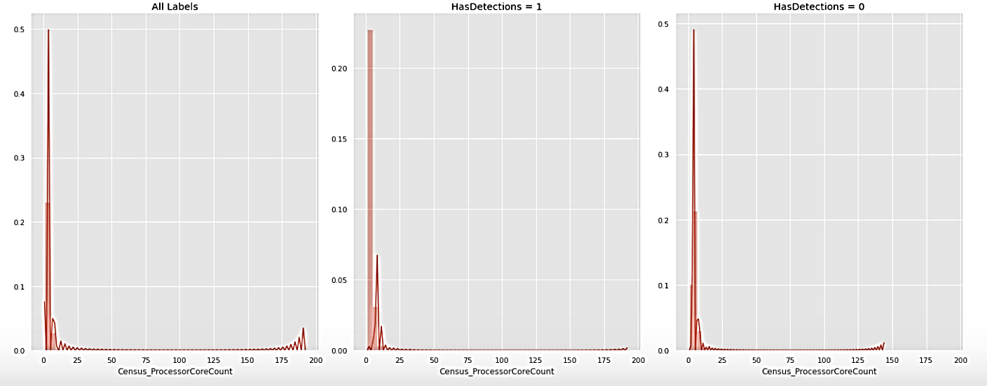
Transforming Skewed Features
Skewness of Numerical Features:
Feature | Skew | Skew after Log Transform
Census_ProcessorCoreCount | 4.30 | 0.18
Census_SystemVolumeTotalCapacity | 2.32 | -
Census_TotalPhysicalRAM | 20.86 | 0.39
Census_InternalPrimaryDiagonalDisplaySizeInInches | 5.25 | 1.71
Census_InternalPrimaryDisplayResolutionHorizontal | 2.47 | 0.92
Census_InternalPrimaryDisplayResolutionVertical | 2.82 | 1.53
Census_InternalBatteryNumberOfCharges | 1.09 | -
Fig: Skew of feature Census_ProcessorCoreCount for HasDetections = 0
Fig: Skew of feature Census_ProcessorCoreCount for HasDetections = 1

Slide 11
Result Analysis After Skew Transformation
 | Feature Set | Model | Accuracy | Precision | Recall | F1-Score
With Skew Transform | 67 Feature set | LGBM Classifier | 0.6452 | 0.6475 | 0.6452 | 0.6437
 |  | CatBoost Classifier | 0.6258 | 0.6523 | 0.6258 | 0.6085
 | Top 57 Feature set | LGBM Classifier | 0.6397 | 0.6474 | 0.6397 | 0.6349
 |  | CatBoost Classifier | 0.6224 | 0.6466 | 0.6224 | 0.6061
Without Skew Transform | Top 57 Feature set | LGBM Classifier | 0.67193 | 0.6736 | 0.6719 | 0.6719
 |  | Cat Boost Classifier | 0.67563 | 0.6771 | 0.6756 | 0.6757

Slide 12
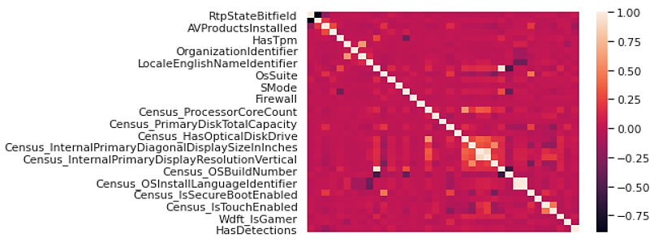
Feature Correlation Analysis
Figure: Feature Correlation Heatmap

Slide 13
Result Analysis and Improvement
Feature Set | No | Model | Accuracy | Precision | Recall | F1-Score
Base Learners Results (using 57 feature set) | 1 | Gradient Boosting Classifier | 0.66503 | 0.6659 | 0.6650 | 0.6651
 | 2 | LGBM Classifier | 0.67191 | 0.6736 | 0.6719 | 0.6719
 | 3 | XGB Classifier | 0.65593 | 0.6582 | 0.6559 | 0.6558
 | 4 | CatBoosting Classifier | 0.67563 | 0.6771 | 0.6756 | 0.6757
 | 5 | AdaBoosting Classifier | 0.65041 | 0.6510 | 0.6504 | 0.6505
5 Base Learners (1,2,3,4,5) |  | SuperLearner | 0.67585 | 0.6770 | 0.6759 | 0.6759
4 Base Learners (1,2,3,4) |  | SuperLearner | 0.67592 | 0.6770 | 0.6759 | 0.6760
3 Base Learners (1,2,4) |  | SuperLearner | 0.67566 | 0.6772 | 0.6757 | 0.6757
2 Base Learners (2,4) |  | SuperLearner | 0.67559 | 0.6770 | 0.6756 | 0.6756

Slide 14
Current Challenges
Additional models tested improved upon previous results provided in Checkpoint 1
On par with upper positions in Kaggle competition leaderboard
Logistic regression: 63.000%
Ridge classifier: 62.000%
XGB classifier: 65.593%
Cat Boost classifier: 67.563%
AdaBoost classifier: 65.041%
Maximize accuracy of newer models to surpass previous maximum accuracy provided in Checkpoint 1

Slide 15
Targeted Progress
Remove data outliers based on z-scores and IQR scores
Implement more rigorous testing for data outliers
Utilize sparse matrices and/or other data preprocessing techniques

Slide 16
References
Kaggle Link: https://www.kaggle.com/c/microsoft-malware-prediction/overview
Dataflow of Super Learner Algorithm Figure: https://machinelearningmastery.com/super-learner-ensemble-in-python/?fbclid=IwAR0_s5RWG0cgZ246qA1doQHdloOL9ICjmJeFgzZRhqTdG65Ri8DSg_995gE

Slide 17


